Slide 1
Tutorial

Slide 2
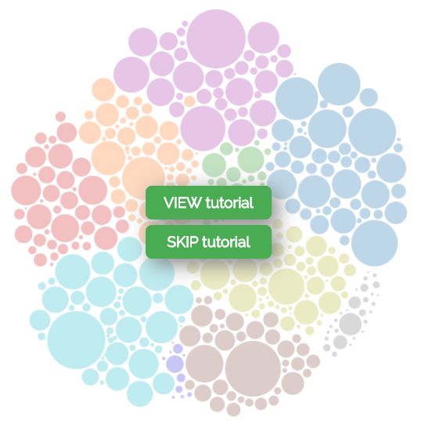
Pave
Is a Canadian
Job Explorer

Slide 3
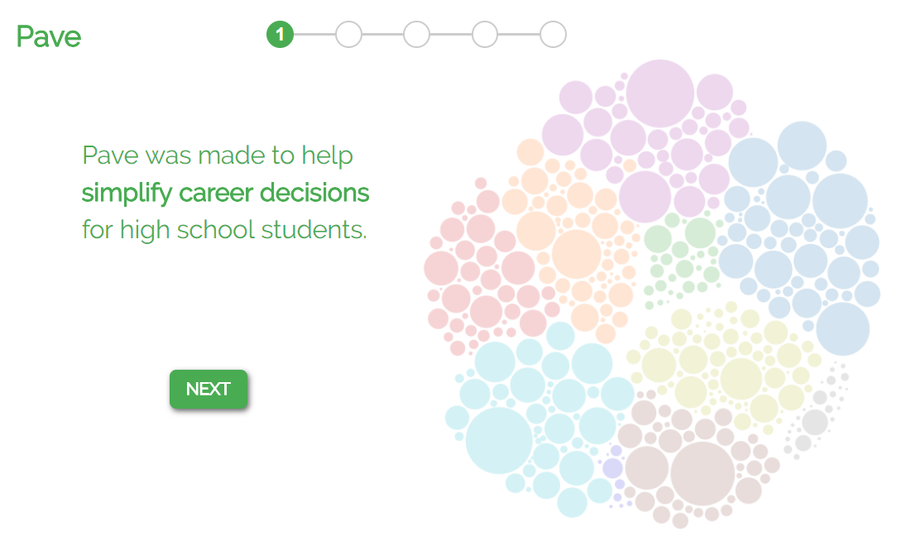

Slide 4
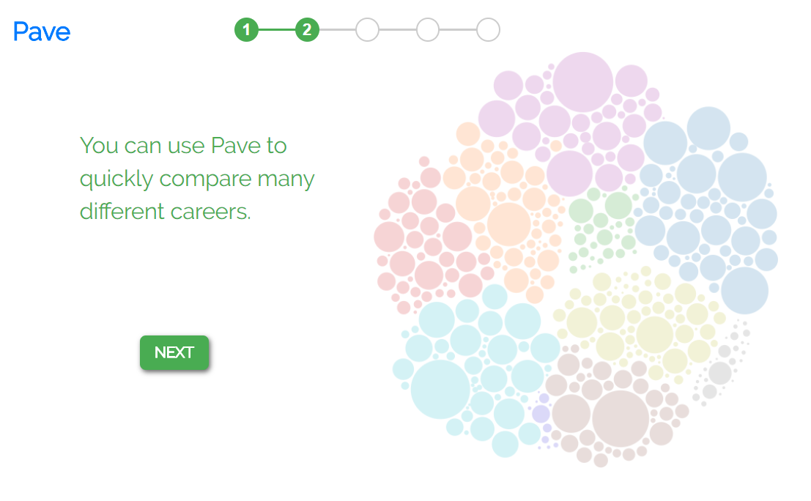

Slide 5
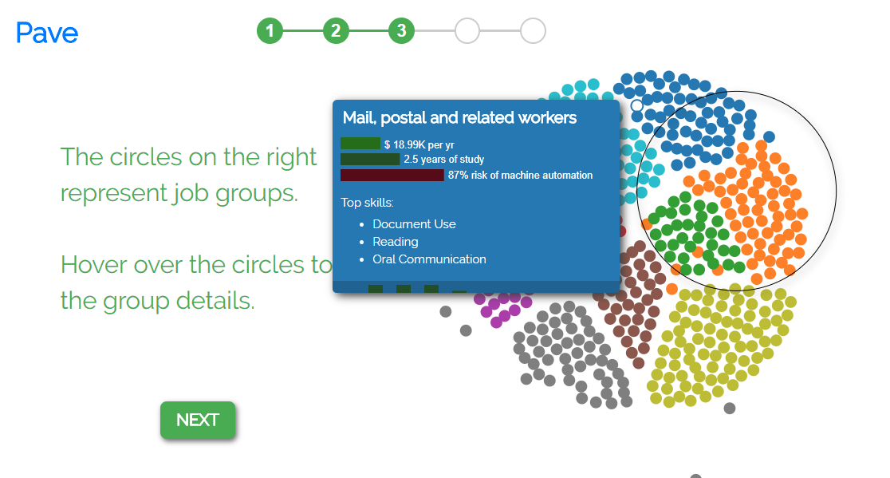

Slide 6
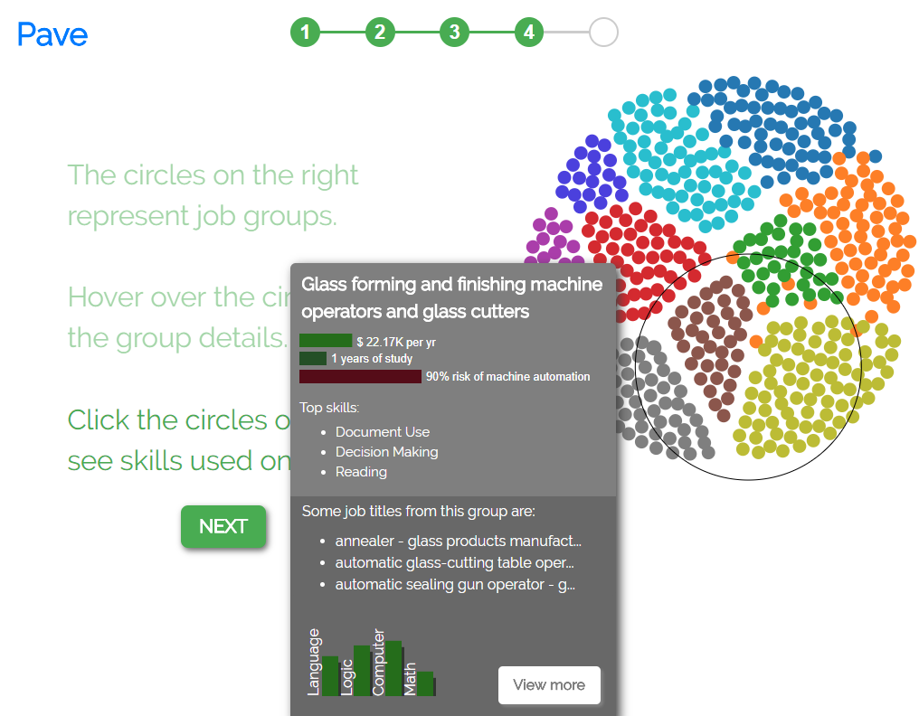

Slide 7
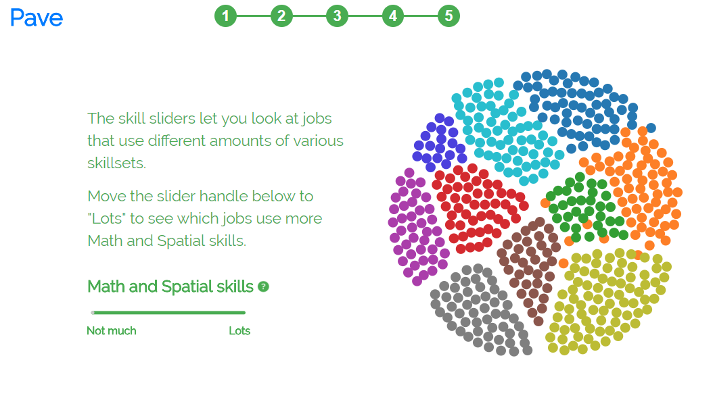

Slide 8
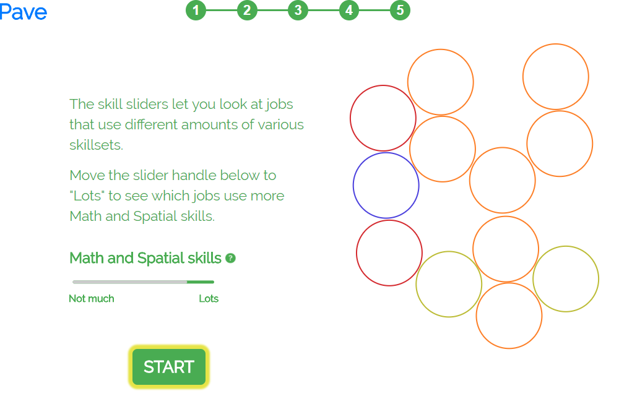

Slide 9
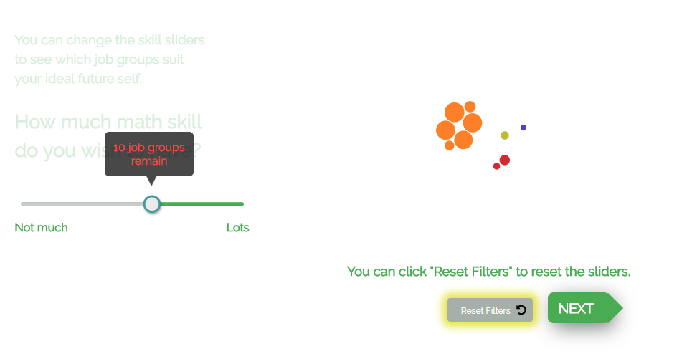


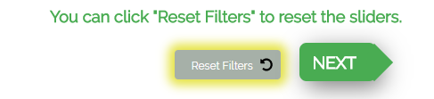

Should this component be included in the tutorial?
Tutorial 4 of 5

Slide 10

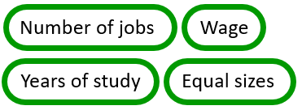
Should this component be included in the tutorial?
Tutorial 5 of 5
Size by:
options

Slide 11

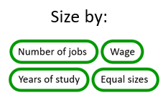

Should this component be included in the tutorial?
Tutorial 5 of 5
options
Number of Jobs

Slide 12
Main page

Slide 13
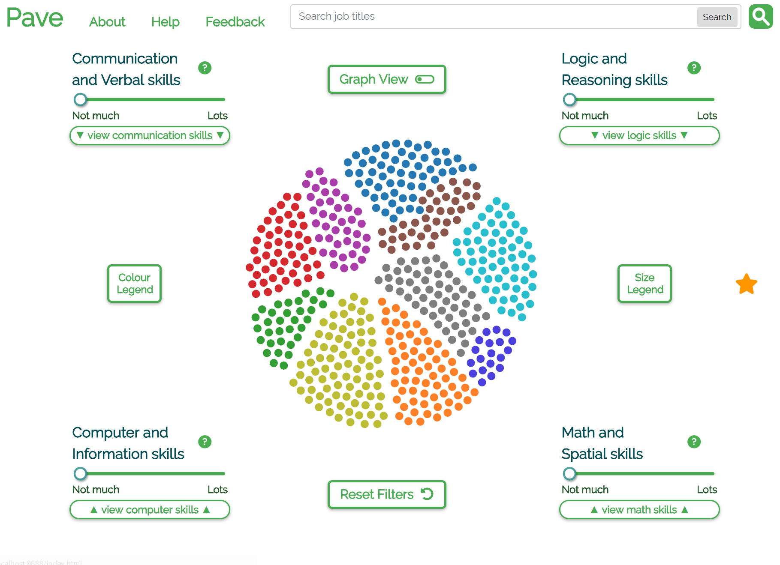
New verbose skill titles (with “inactive text” colour)
Favourites star invisible until favourites added

Slide 14
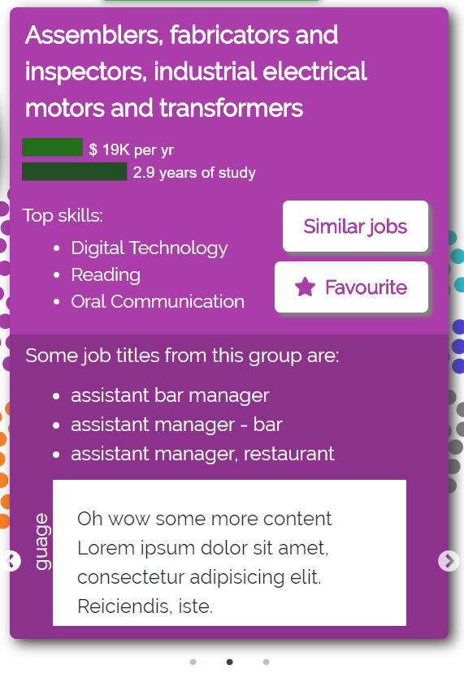
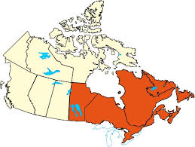
Tooltip currently contains 3 carousel slides (most important first):
Filled map of available program locations (+ tuition cost and/or years of study?)
Zoomable job stats & x/5 star rating
?
1
2
3
Can I do this?
Should I do this?
How do I do this?
Schools & locations (maybe a filled map?)
Average GPAs
Prerequisites
Ratings out of 5 stars
How likely am I to get this job
Job outlook
Input, output, in/out ratio
School websites
Online courses
Volunteer opportunities
Job postings?

Slide 15
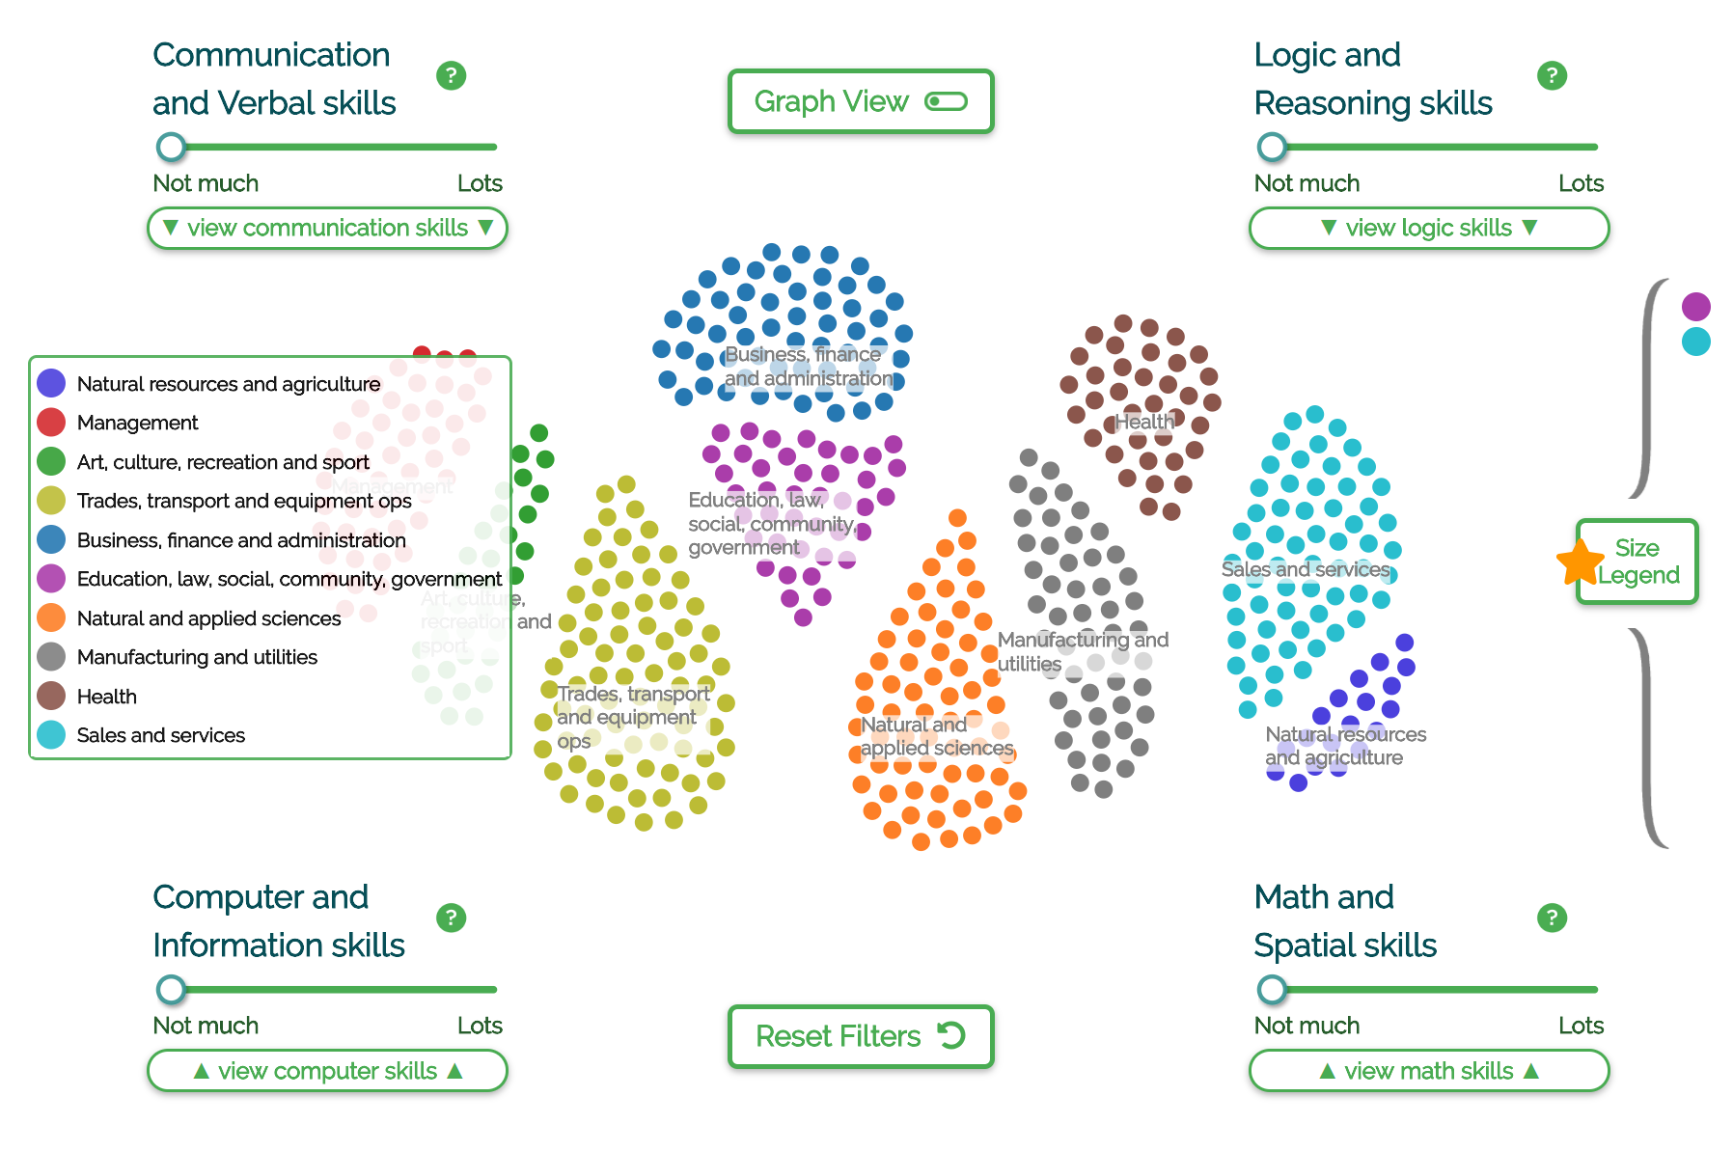
Colour legend with centered labels (should favourites collapse on colour legend click?)

Slide 16
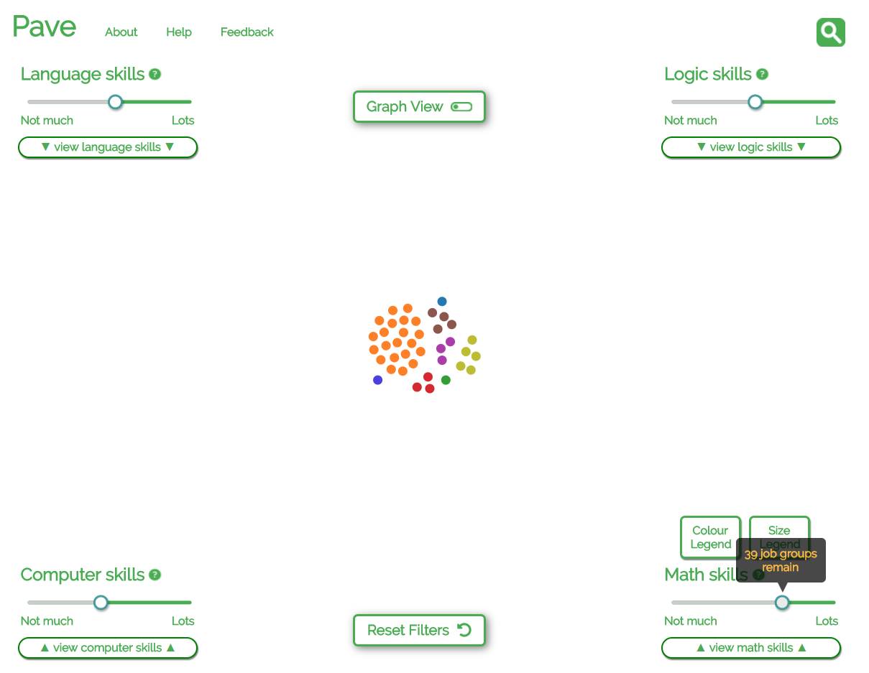

Slide 17
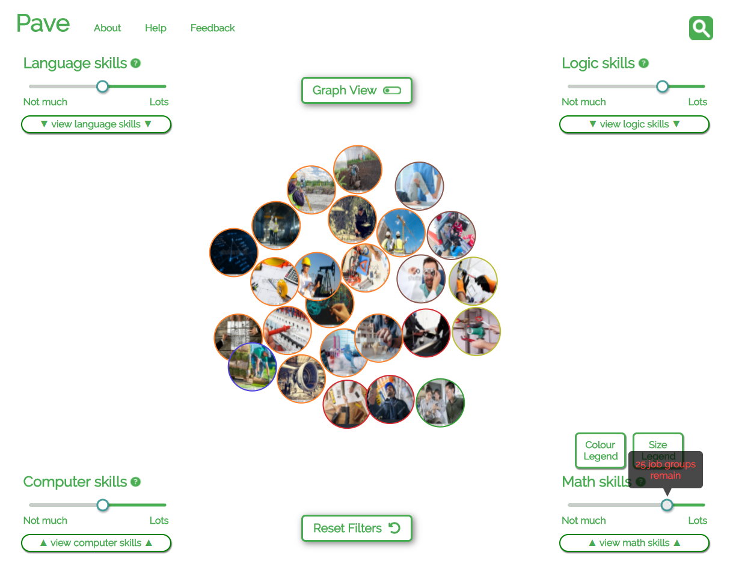

Slide 18
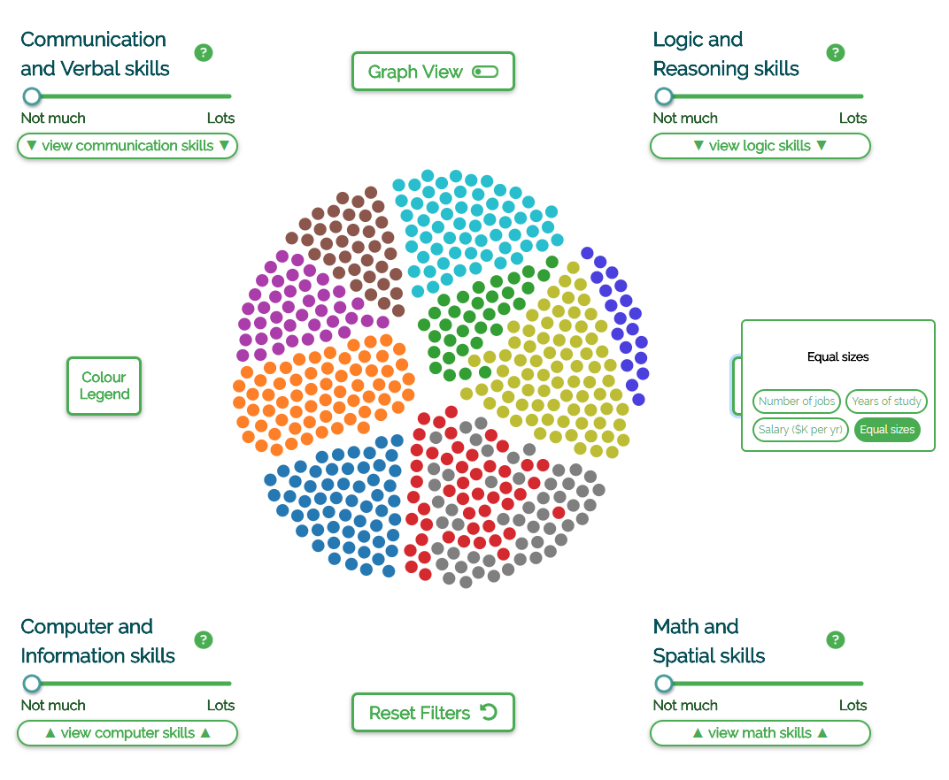
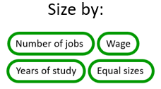

Slide 19
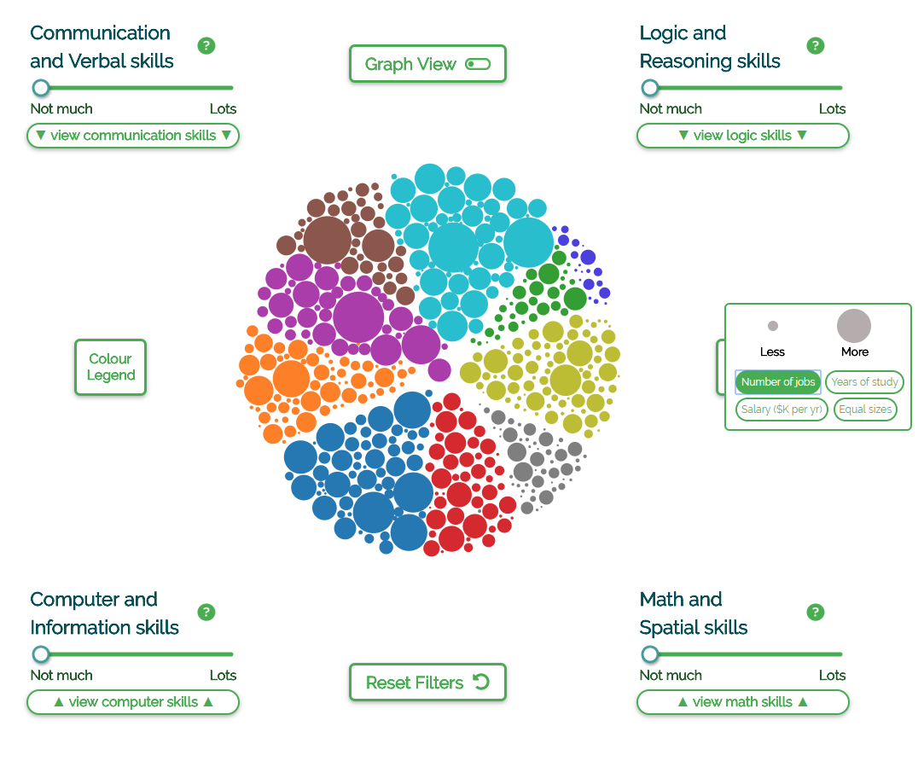

Slide 20
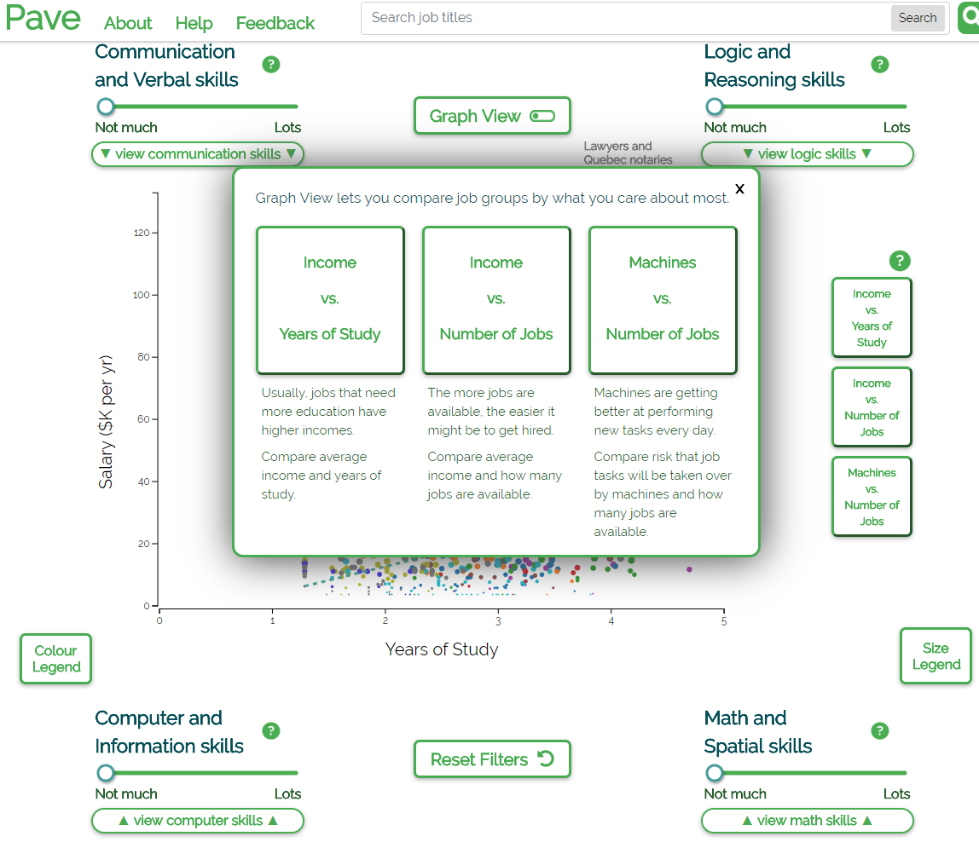

Slide 21
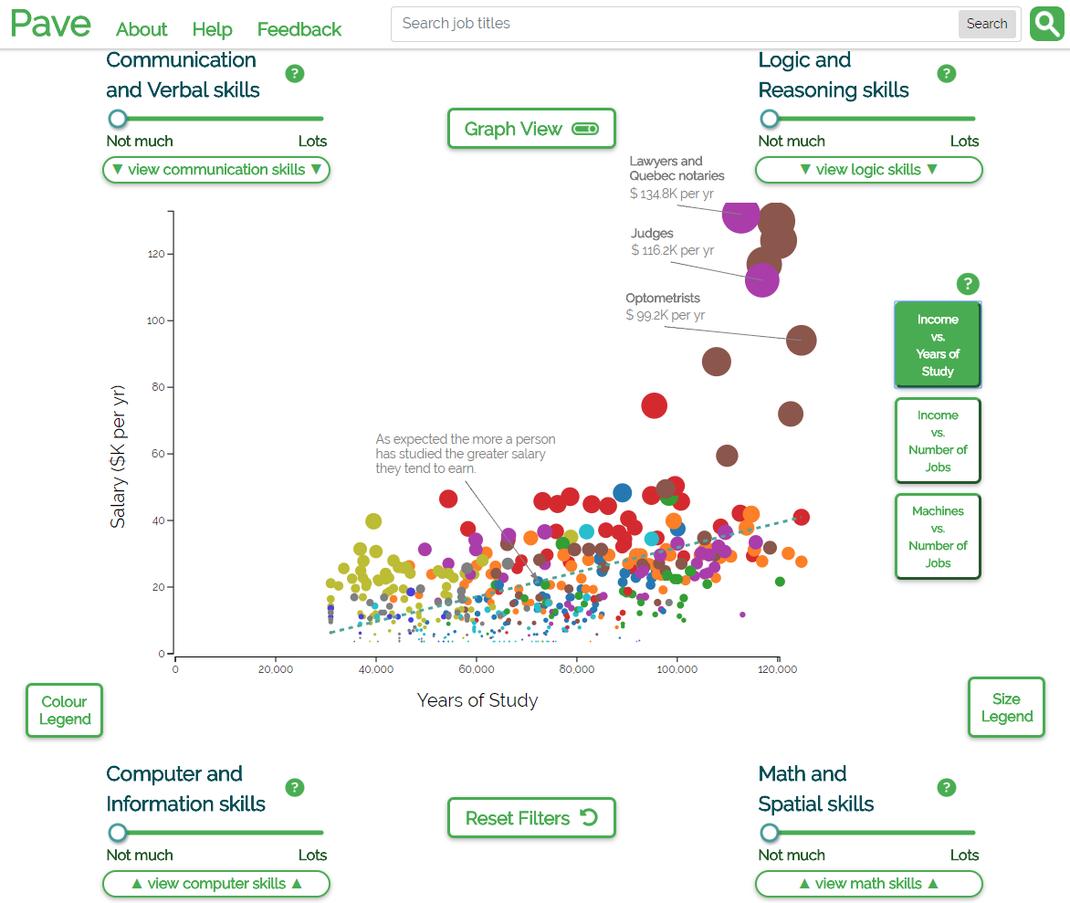

Slide 22
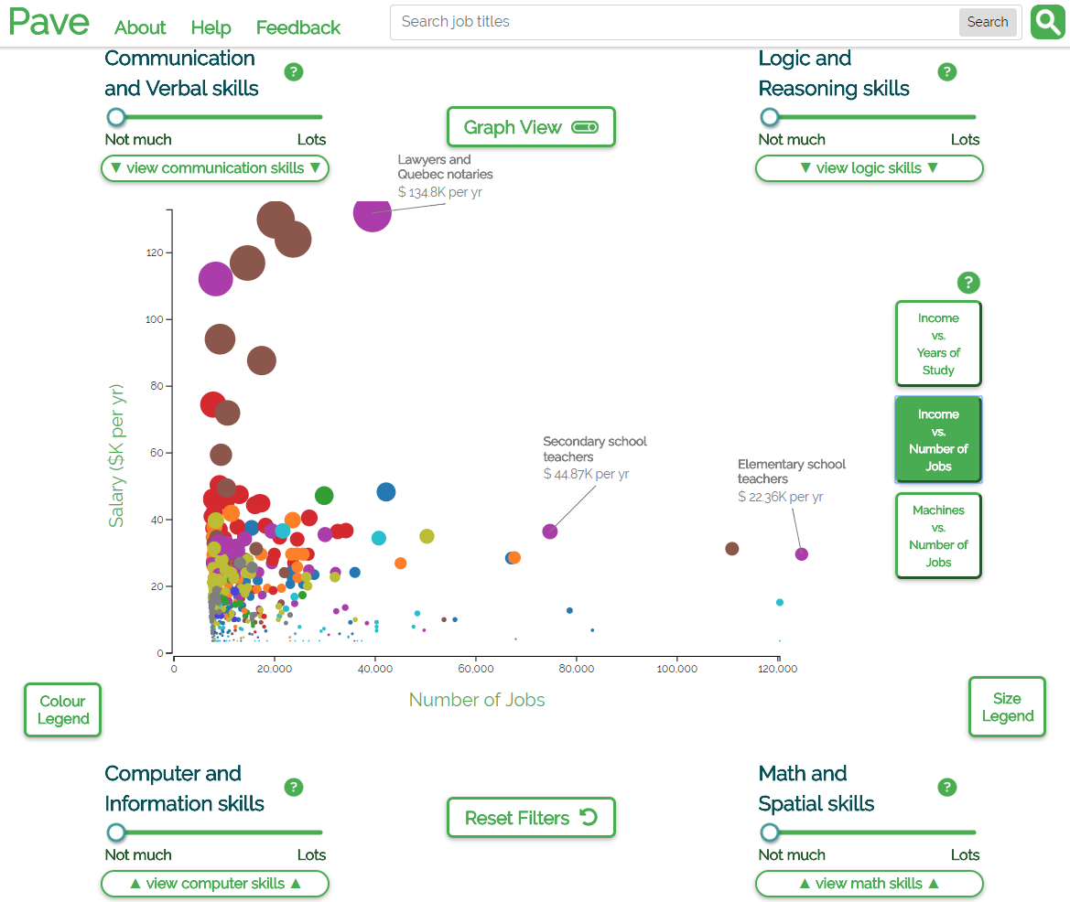

Slide 23
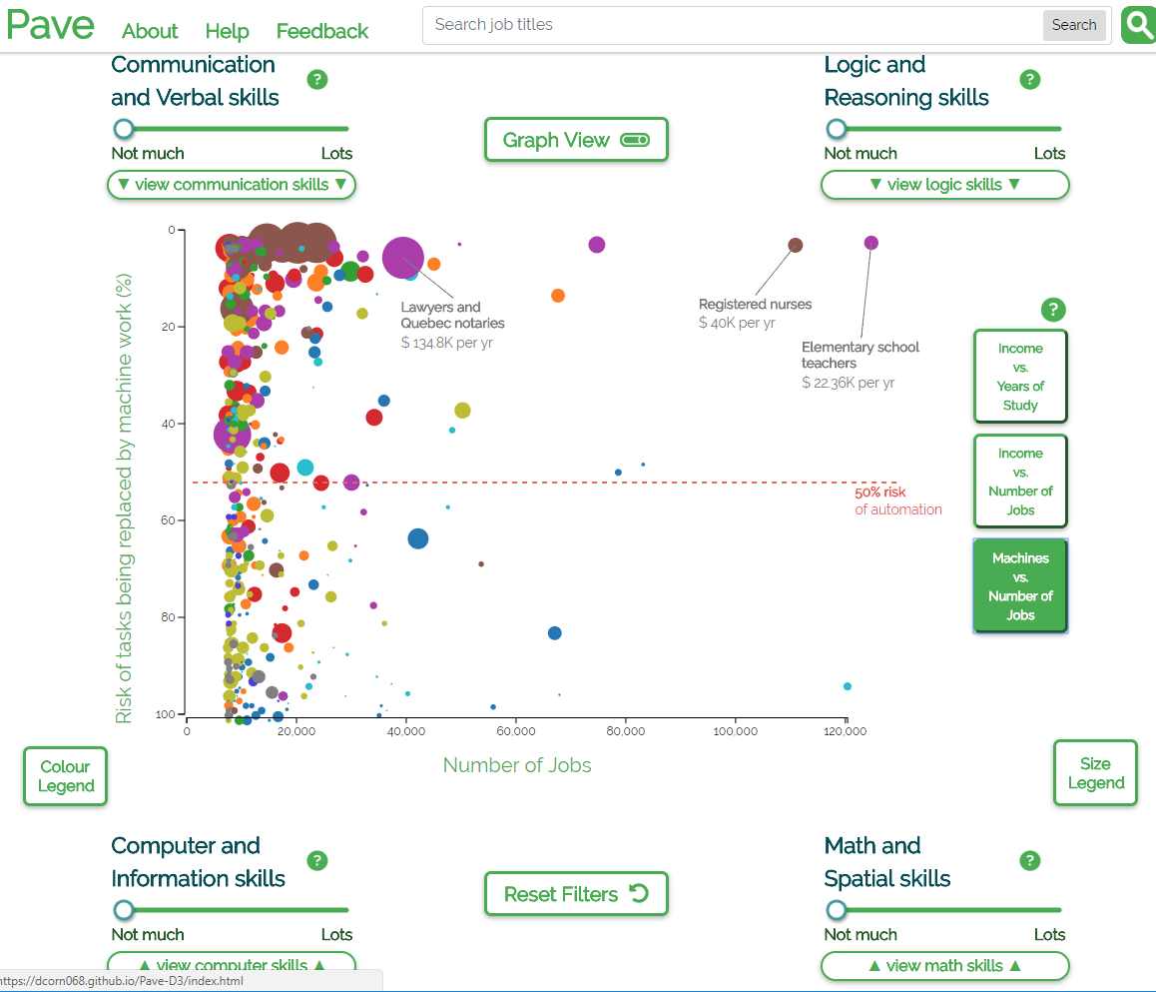

Slide 24
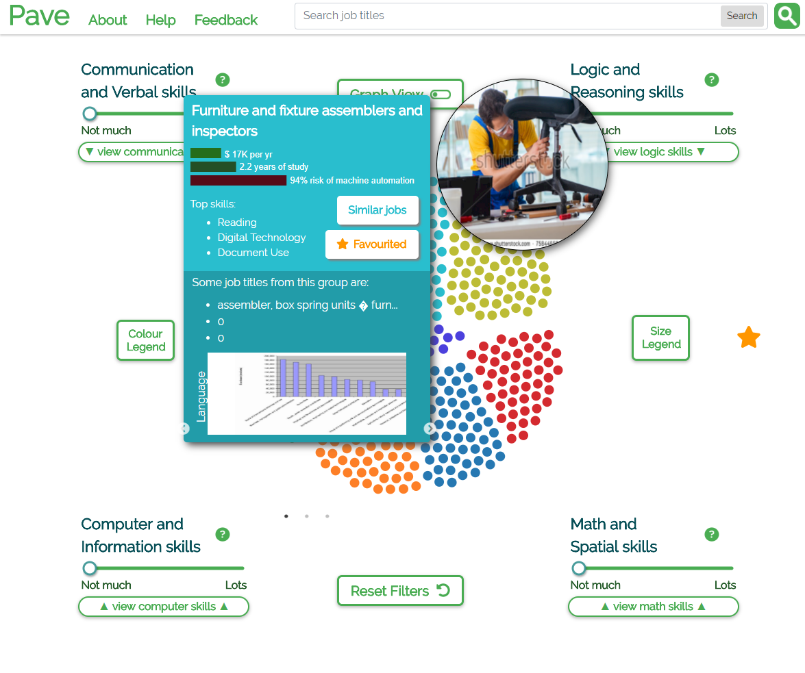
Favourites panel on the right

Slide 25
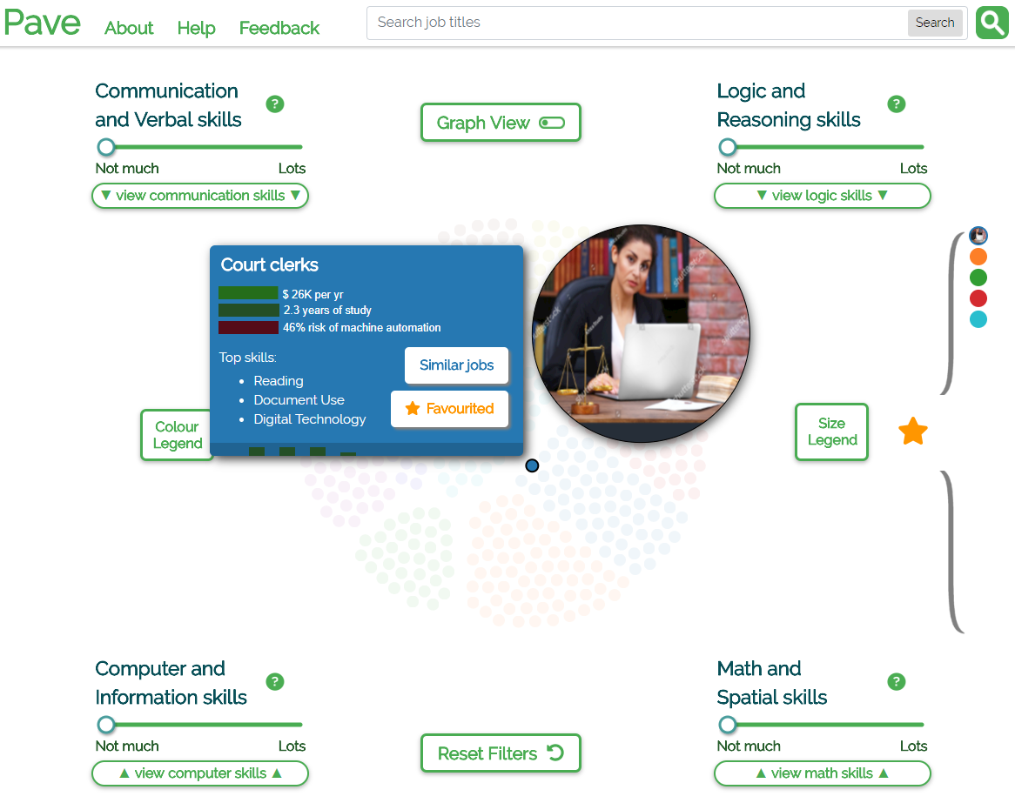
Hover in the favourites panel to highlight favourites

